Slide 1
Hospital Management System
Implemented by
Mohamed Abdelaal Mahmoud Abdelaal

Slide 2

Introduction to Hospital Management Systems
Hospital Management Systems (HMS) are critical in enhancing the efficiency of healthcare delivery. This presentation provides a comprehensive overview of HMS, focusing on their role in optimizing patient care, streamlining operations, and improving overall hospital performance.

Slide 3

What is a Hospital Management System?
A Hospital Management System is an integrated software solution designed to manage all aspects of a hospital's operations. From patient registration to billing, HMS enhances efficiency and ensures seamless communication across departments.

Slide 4
Key Features of HMS
Key features of HMS include patient management, appointment scheduling, billing, and reporting. These features facilitate better data management and improve the quality of patient care.

Slide 5

System Overview
The system has two interfaces: one for administrators and another for patients, each with unique features.

Slide 6

Technologies Used
ASP.NET Core
SQL Server
Bootstrap,
jQuery
Html
CSS
JavaScript

Slide 7
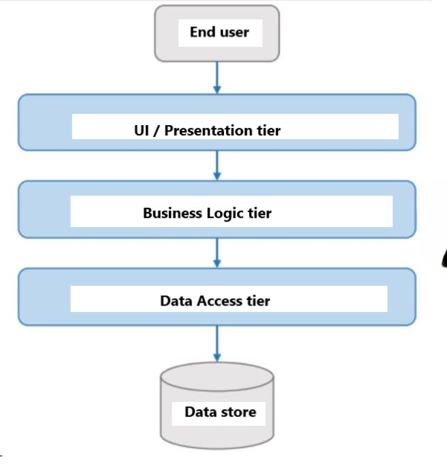
System Design
Architectural Design
Architecture: Multi-tier architecture with separation of concerns.
Presentation Layer: Implements the user interface with Bootstrap for responsive design and ASP.NET MVC for routing and views.
Business Logic Layer: Core logic and service classes designed following SOLID principles to ensure scalability and maintainability.
Data Access Layer: Entity Framework with SQL Server for data handling.

Slide 8
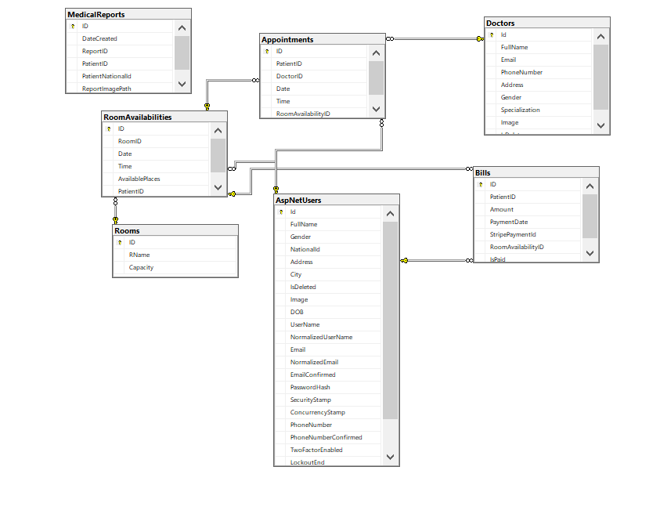
System Design
Database Design
Database Management: SQL Server
Key Tables and Relationships: Tables for users, doctors, appointments, rooms, reports, and bills, including details on primary/foreign keys and relationships.
ER Diagram: An entity-relationship diagram displaying tables, fields, and relationships.

Slide 9

Features and Functionalities
Patient Interface
Authentication: Registration, login, and password management with password reset.
Profile Management: View, edit, and delete profile information.
Doctor Search and Appointment Management: Browse doctors, book appointments, and view details.
Reports and Bills: Access past medical reports and billing details.
Payments: Integration with a payment gateway for online bill settlement.

Slide 10
Features and Functionalities
Administrator Interface
User and Role Management: Assign and manage user roles, including doctor and patient roles.
Doctor and Room Management: Add, update, and remove doctor profiles and hospital room details.
Patient Management: Access all patient-related features, including the ability to manage appointments, reports, and bills.
Report Generation: Generate, view, and manage patient reports.

Slide 11

Implementation Details
Security and Authentication
Password Reset Functionality: Implements secure password reset through email.
Client-Side Validation
Bootstrap Forms: Form validation to ensure data integrity and improve user experience.

Slide 12
Implementation Details
Payment Gateway Integration
Implementation: Step-by-step process of integrating the payment gateway, handling payment success and failure, and ensuring transaction security.
Code Design with SOLID Principles
Separation of Concerns: Clear demarcation between different responsibilities within the codebase.
Class and Interface Design: How classes and interfaces adhere to SOLID principles, ensuring a scalable and maintainable code structure.

Slide 13
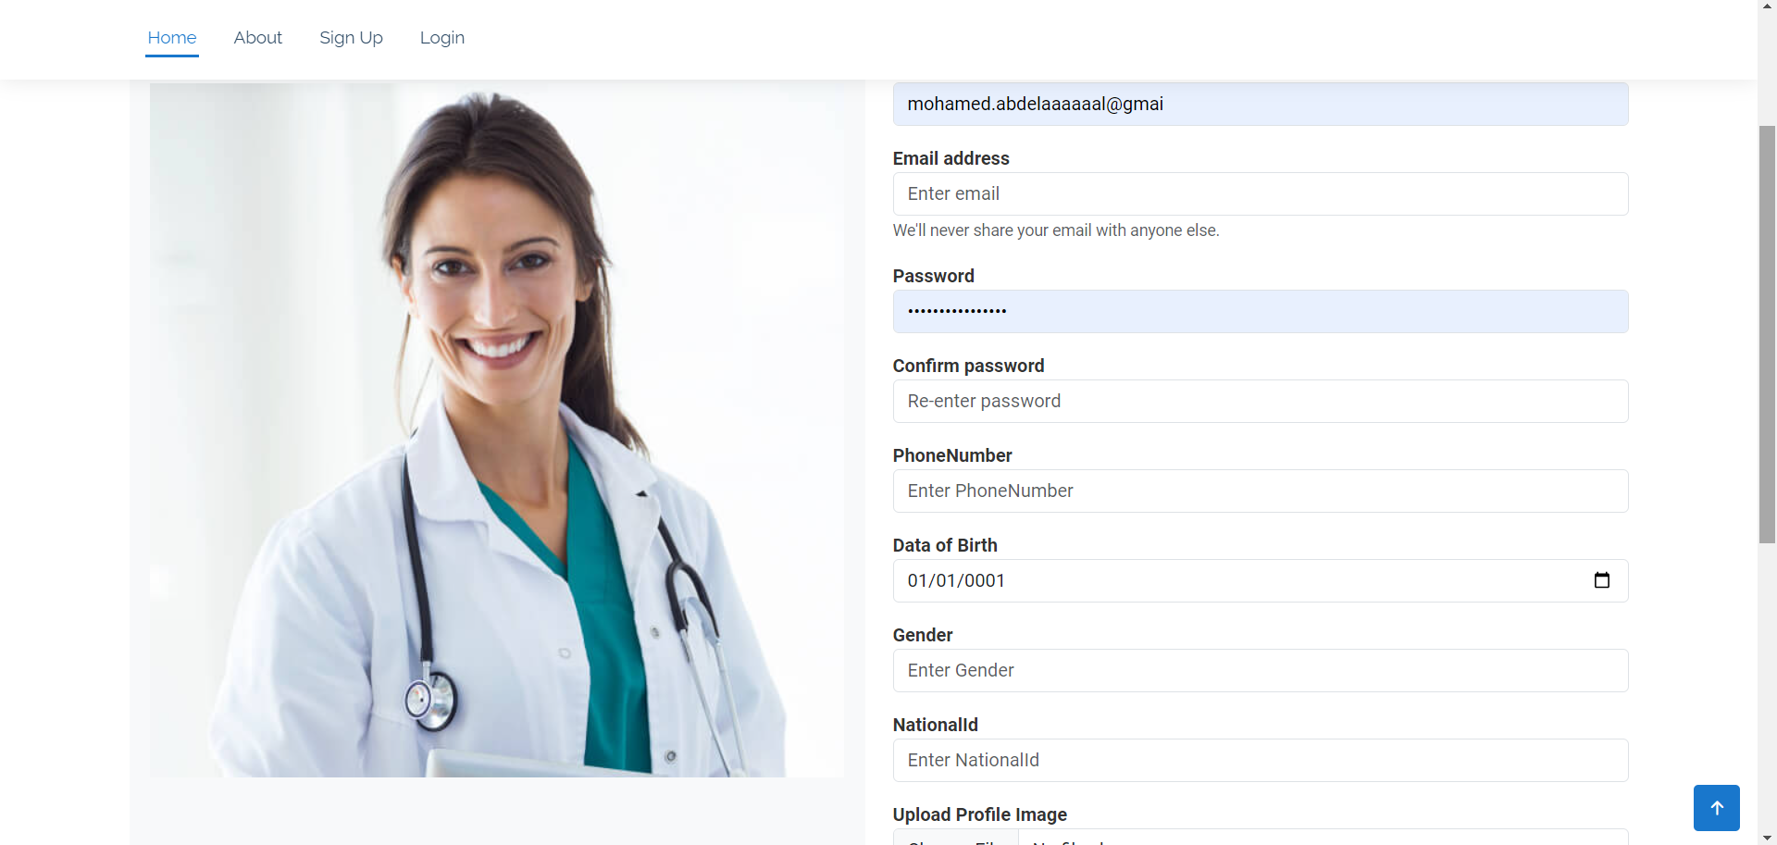
User Interface Design
Register

Slide 14
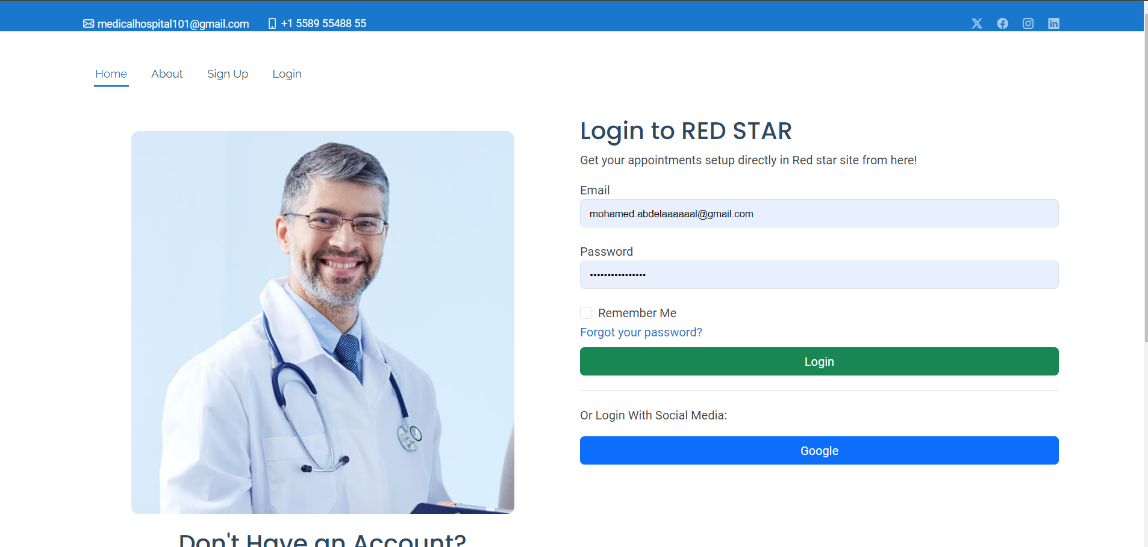
User Interface Design
Login

Slide 15
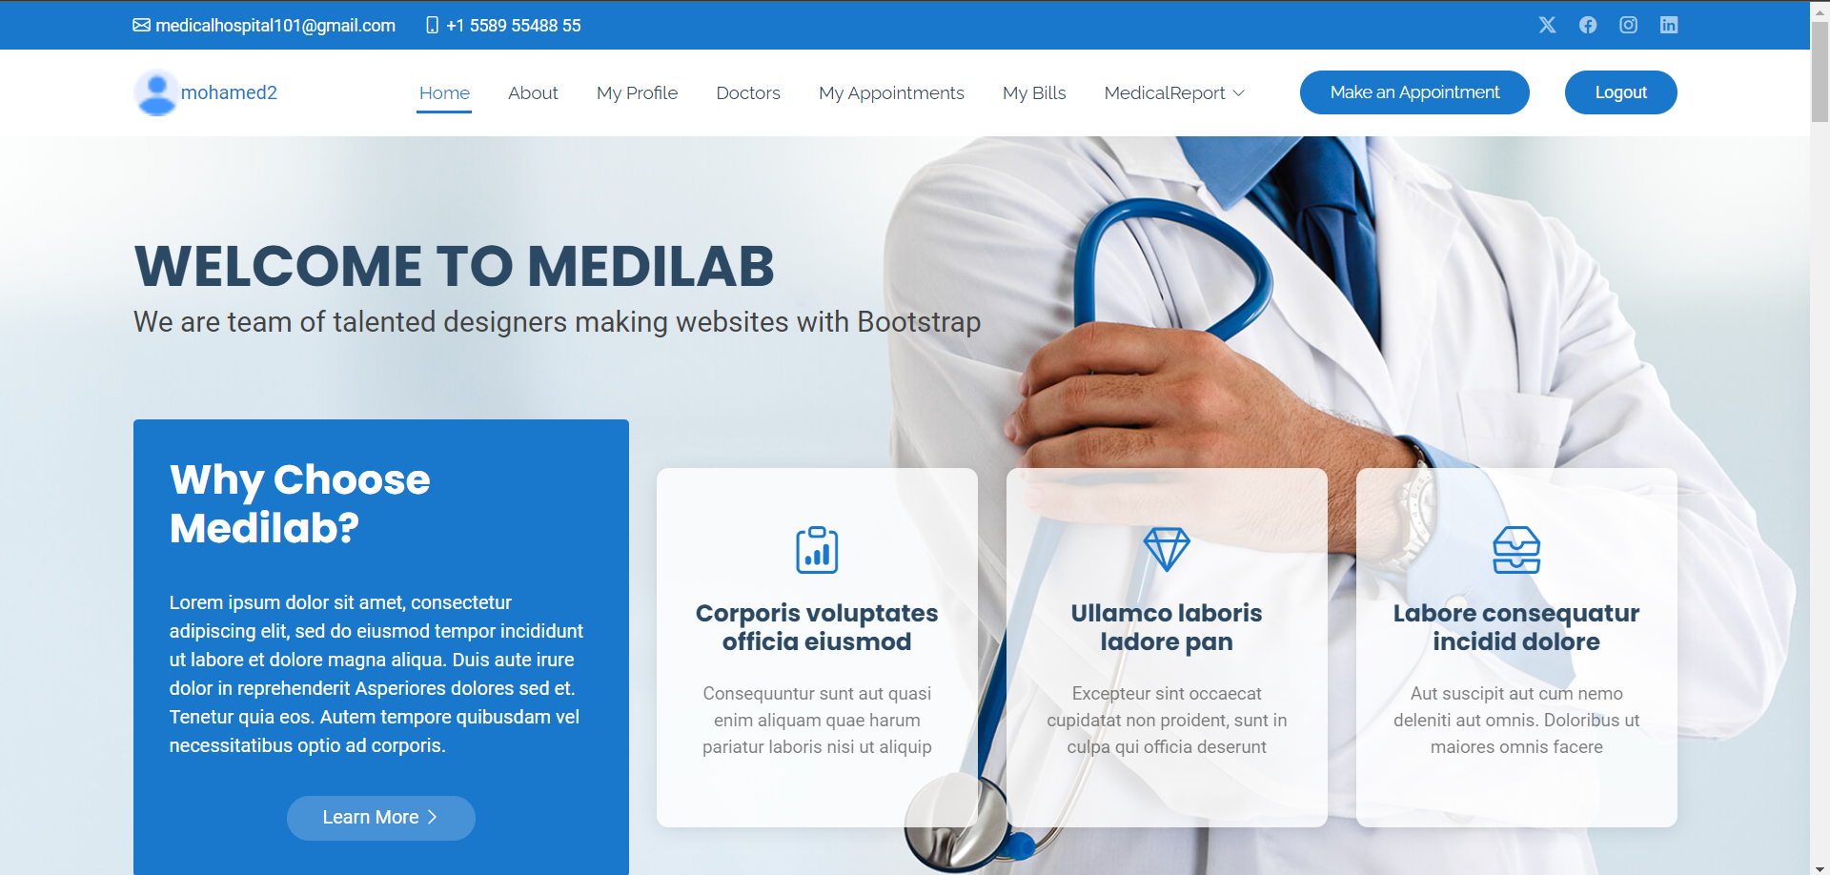
User Interface Design
Home

Slide 16
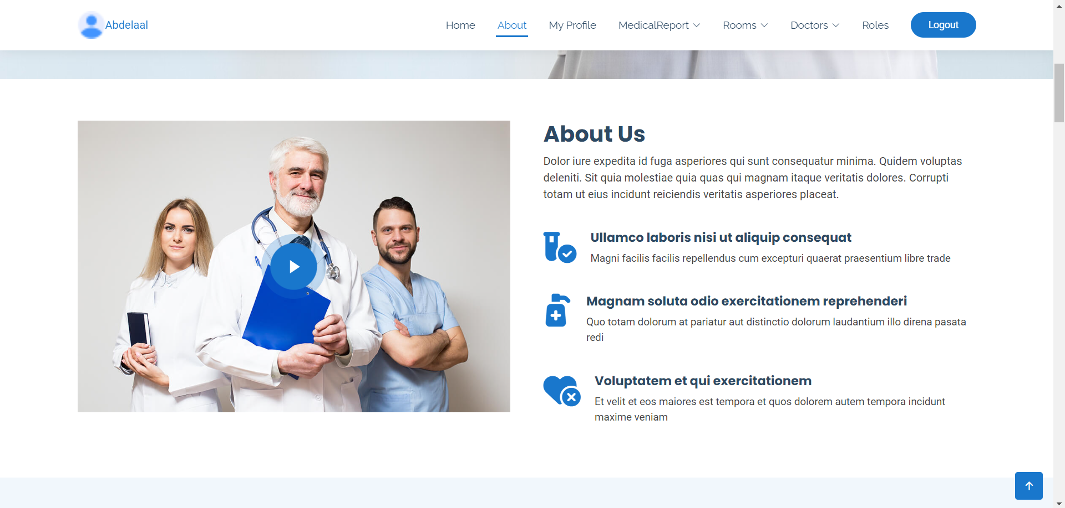
User Interface Design
About

Slide 17
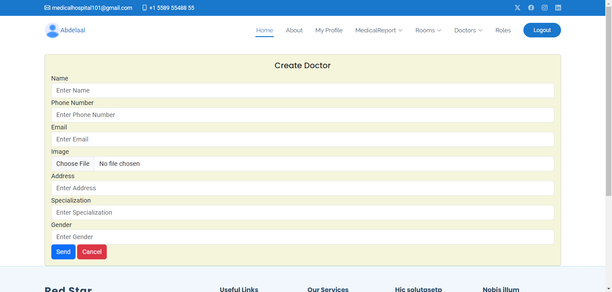
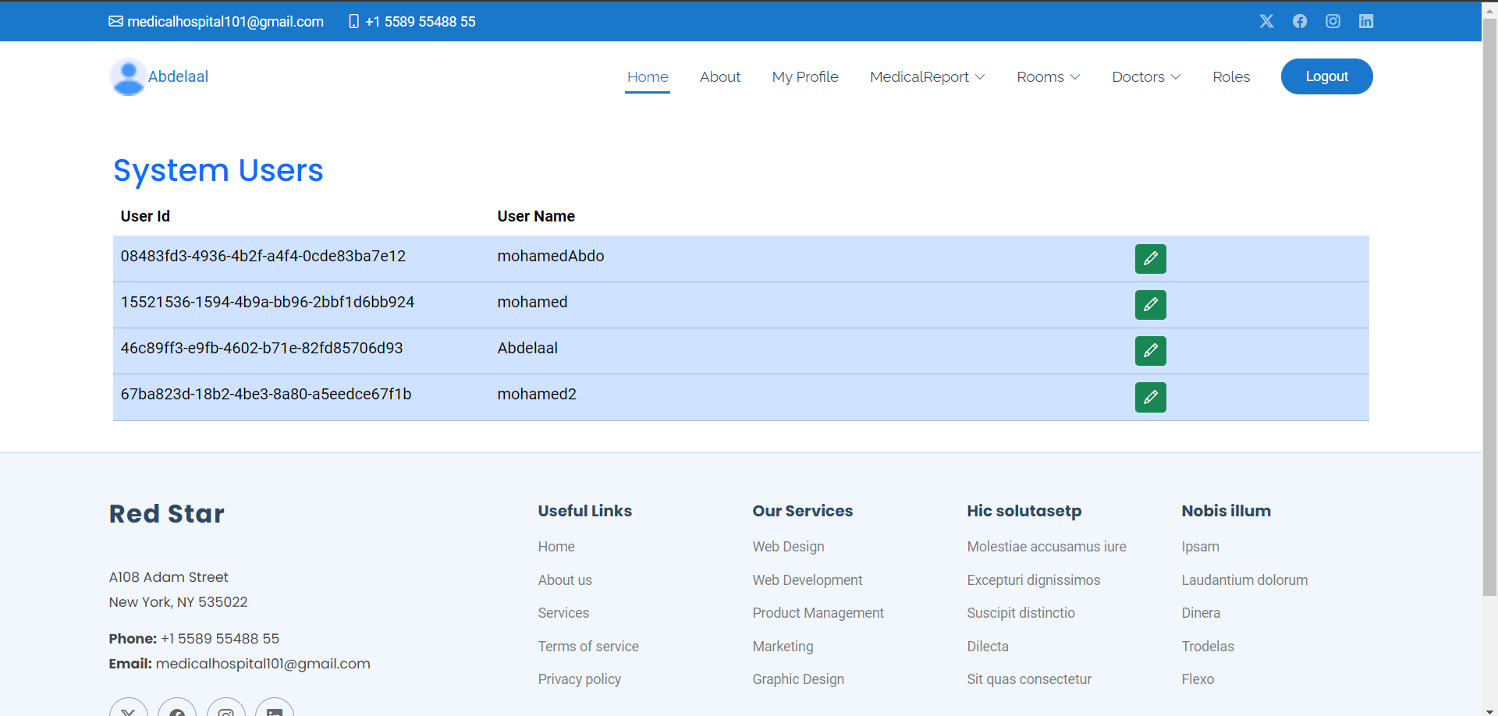
Admin Interface
Admin Manage Users
Admin Create Doctor

Slide 18
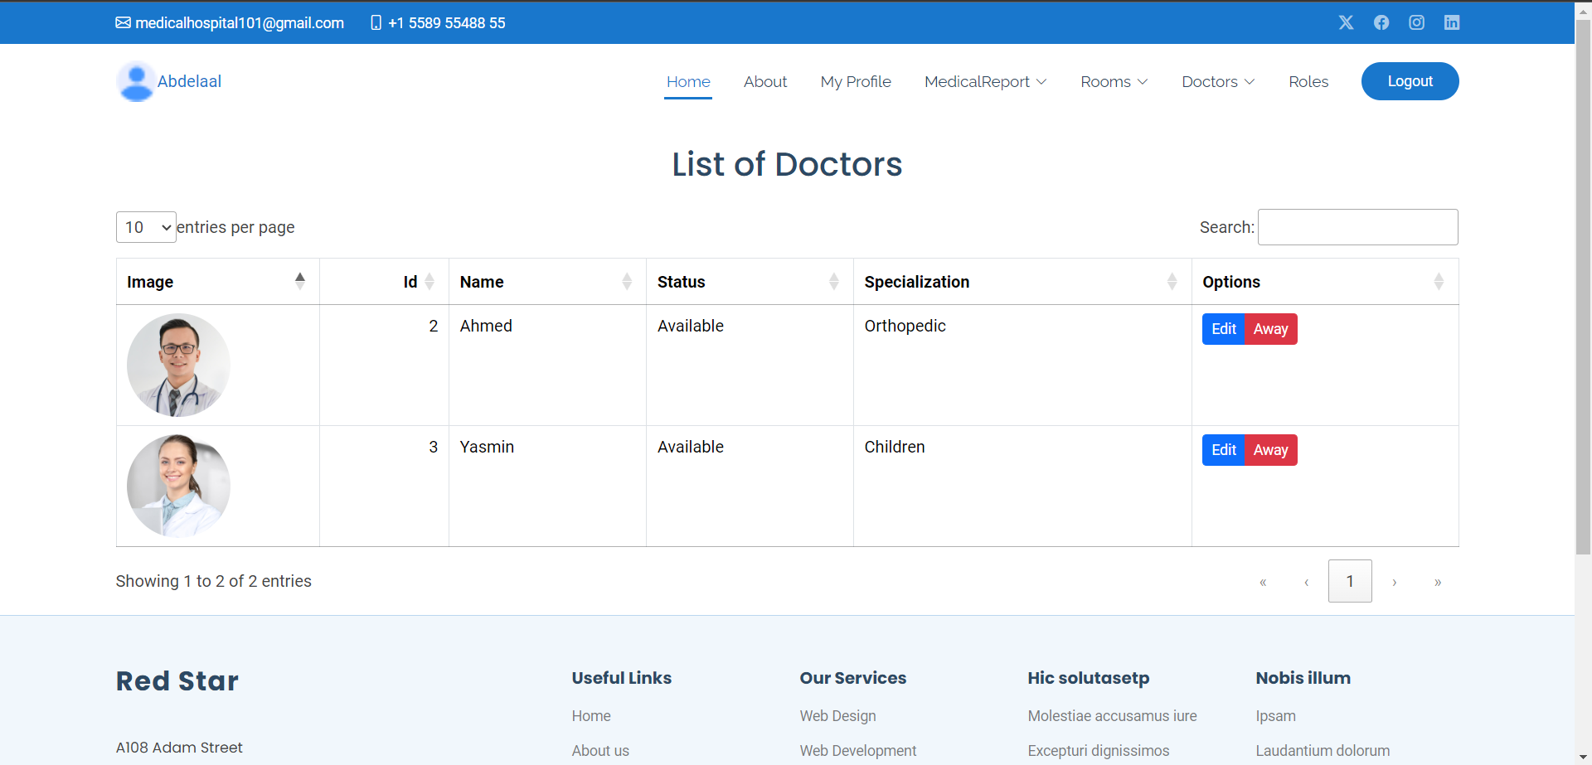
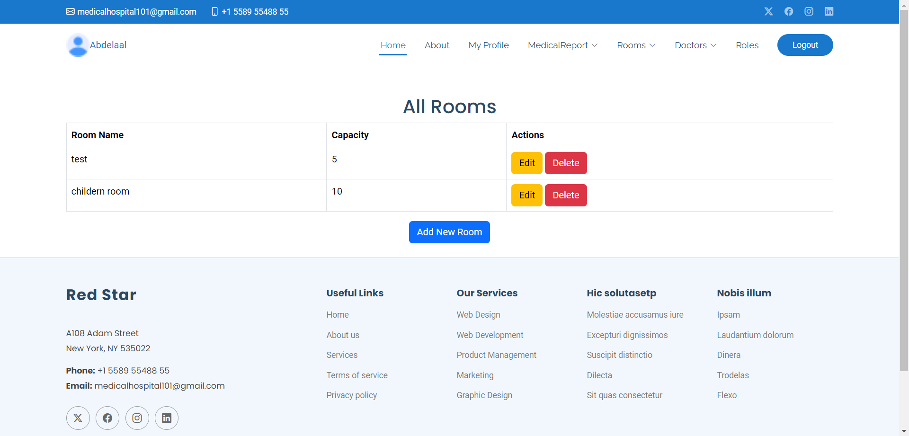
Admin Interface
Admin Manage Doctors
Admin Manage Rooms

Slide 19
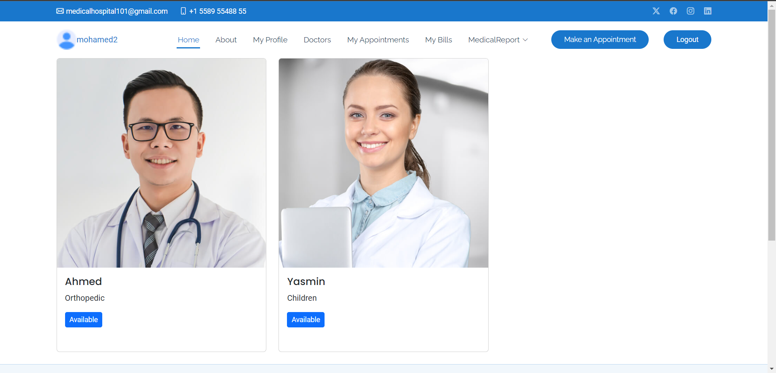
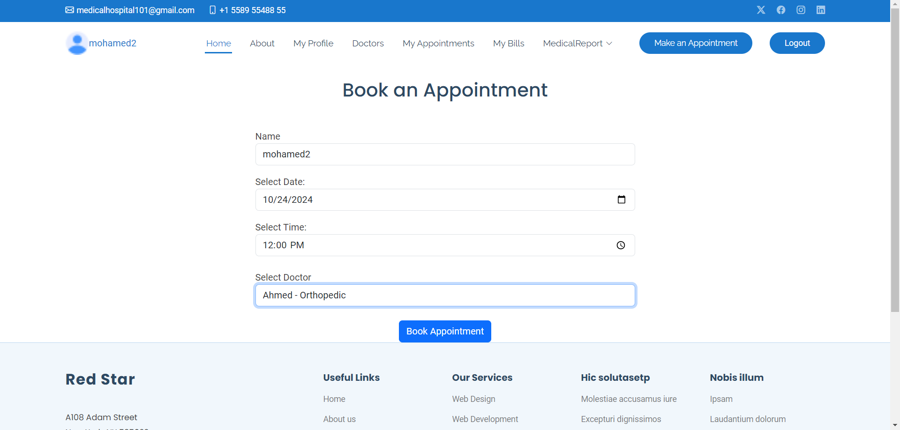
Patient Interface
Patient Show Doctors
Patient Book an Appointment

Slide 20
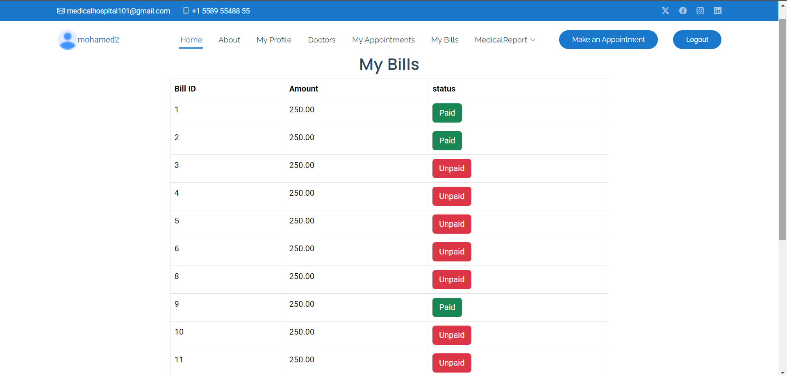
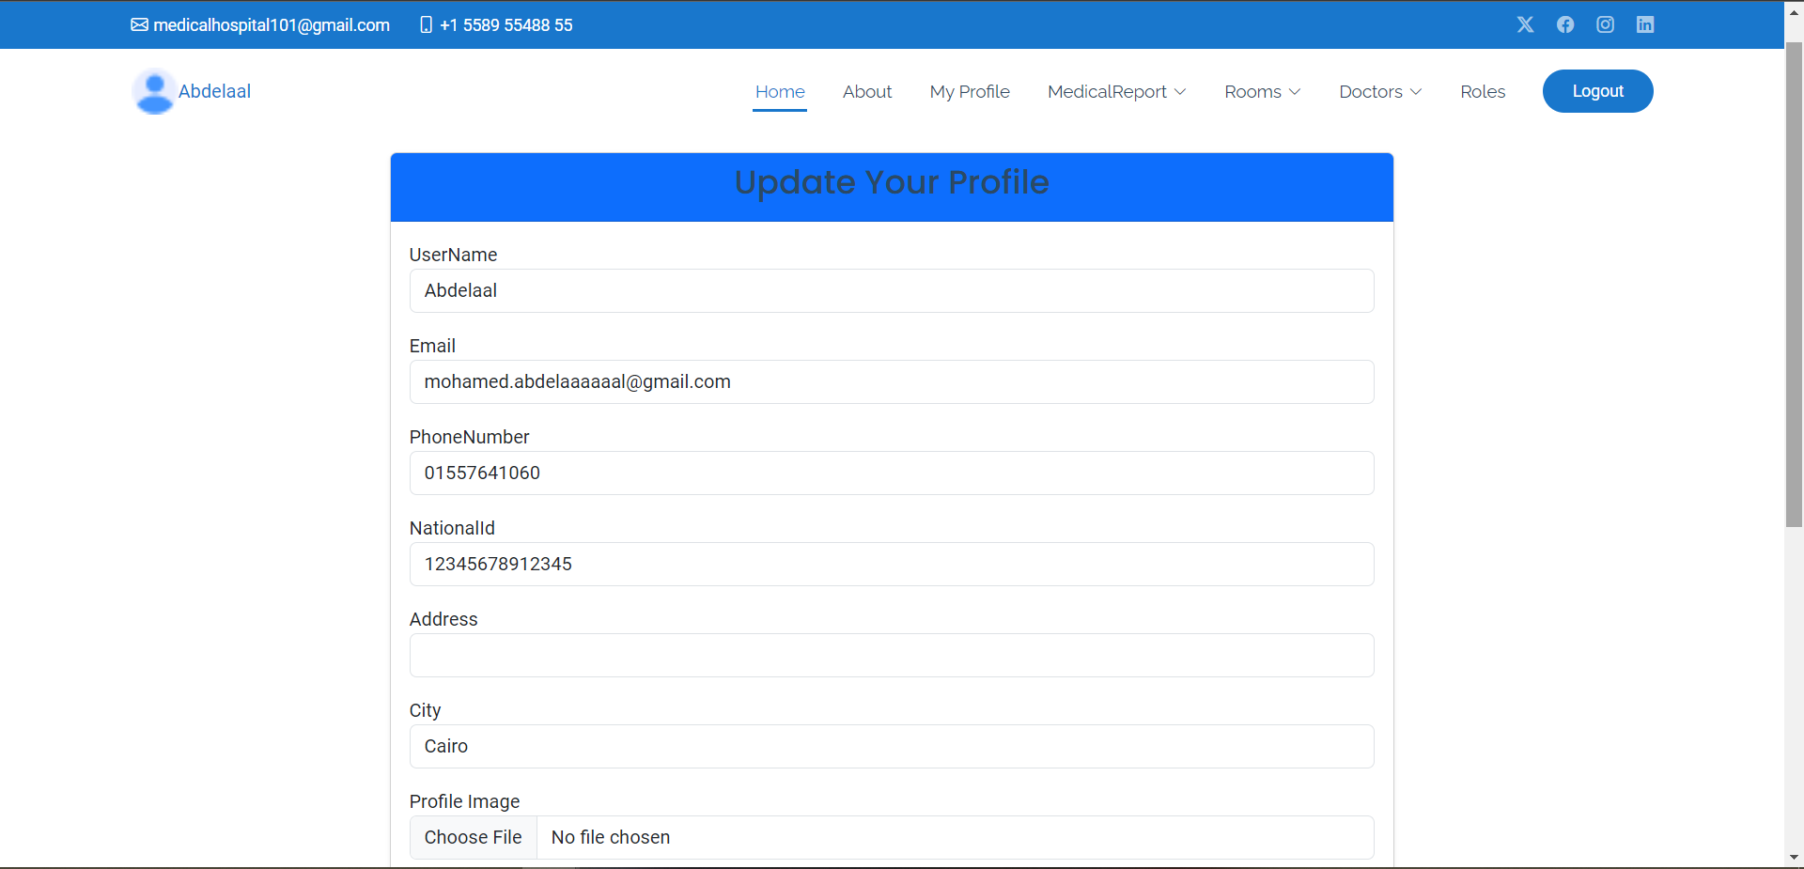
Patient Interface
Patient`s Bills
Update Profile

Slide 21
Testing and Quality Assurance
Testing Strategy
Unit Testing: Explanation of the tests written for business logic components.
Integration Testing: Validation of end-to-end workflows between modules, especially for payment and authentication.
Error Handling and Logging
Error Handling Mechanisms: How common errors are managed within the system.
Logging: Overview of logging practices for debugging and performance monitoring.

Slide 22

Deployment
Environment Setup
Local Deployment:
Requirements: Ensure that you have the following installed: Microsoft Visual Studio Code
.NET Core SDK
SQL Server (or SQL Server Express for local testing)
Git (for version control)
Production Deployment (Using IIS):
Server Requirements:
Windows Server with IIS installed.
.NET Core Hosting Bundle installed on the server.
SQL Server (accessible from the production environment).

Slide 23
Future Enhancements
Potential features to enhance functionality, such as automated scheduling, detailed analytics for hospital management, and telemedicine integration.

Slide 24

Conclusion
In conclusion, Hospital Management Systems are vital for optimizing healthcare delivery. By enhancing operational efficiency, improving patient care, and ensuring data security, HMS plays a crucial role in the future of healthcare.

Slide 25
Thanks!
ANY QUESTIONS?

